Slide 1

Tutorial: SDN Programming Using High-Level Abstractions
Mingming Chen, Kai Gao, Shawn Lin, Charlie Proctor, May Wang, Tony Wang, Qiao Xiang, Jensen Zhang, Y. Richard Yang
Systems Networking Lab (SNLab)

Slide 2
Outline
Overview
Maple: datapath oblivious programming
FAST: data-driven, function-composition programming
Summary and pointers to additional info

Slide 3
Conceptual Intro: The FAST Maple Programming Model

Slide 4

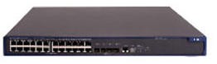
Context
SDN
Biggest lacking of networking: not enough good abstractions in network control plane.
Control
State
standard control
protocol
Datapath
“Modularity based on abstraction is the way things get done.” -- Barbara Liskov
Datapath
Datapath
Notes:
Why abstractions
“Modularity based on abstraction is the way things get done.” -- Barbara Liskov
Why powerful tools
[control plane give rifle, not food

Slide 5
Key OpenDaylight Programming Abstraction: Data Store
Network Devices
Applications
Network Applications Orchestration & Services
Network Devices
Applications
Network Devices
Applications
Controller
NETCONF SERVER
Protocol Plugin
...
Protocol Plugin
App/Service Plugin
...
App/Service Plugin
RESTCONF
Plugins & Applications
Config Subsystem
Model-Driven SAL (MD-SAL)
Controller Platform
Messaging
Data Store
Clustering
Remote Controller Instance
Remote Controller Instance
Source: Ed Warnicke, July 27, 2015.
5

Slide 6
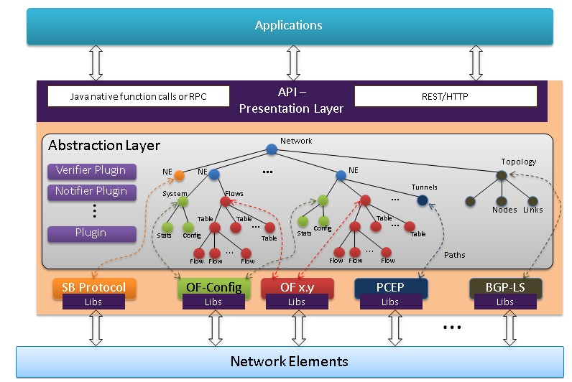
Key OpenDaylight Programming Abstraction: Data Store
Source: https://wiki.opendaylight.org/view/OpenDaylight_Controller:Architectural_Framework

Slide 7



Our Scope
programming to fill the gap
logically centralized data store
Network State
Declarative Policy
Net Elem Datapath
Net Elem Datapath

Slide 8

The FAST Maple Programming Model
Goal: Can we let programmers write the most obvious SDN programs?
consider each pkt as a request
- A network as a single virtual server
- Control program expressed in general purpose programming language (Java in ODL), (logically) invoked on each pkt
- Program returns a high-level instruction on how a pkt is handled
Notes:
Route onPacket( pkt )

Slide 9
Challenges Realizing the FAST Maple Programming Model
Controller becomes a single point of bottleneck in a naïve implementation
Despite logical centralization, still a complex system consisting of a large number of functions, where functions can be data-driven, highly dynamic functions
Complex programming environments
Notes:
5Tb/s, 1000bits/pkt => 5B pkts/s
Efficient datapath to scale but semantic gap

Slide 10
Roadmap
The Maple system, to provide a high-level algorithmic policy programming model, to enable datapath-oblivious programming, to address the low-level datapath issue
The FAST system, to provide a function store abstraction, to address the issue of complex system consisting of a large number of service functions driven by dynamic data
A Web-based (c9 based) based SDN IDE [devopen], to provide a DevOp UI to simplify the programming environment for the preceding two new programming abstractions.

Slide 11
Conceptual Intro: The Programming-Level Gap Problem, The Maple Approach

Slide 12
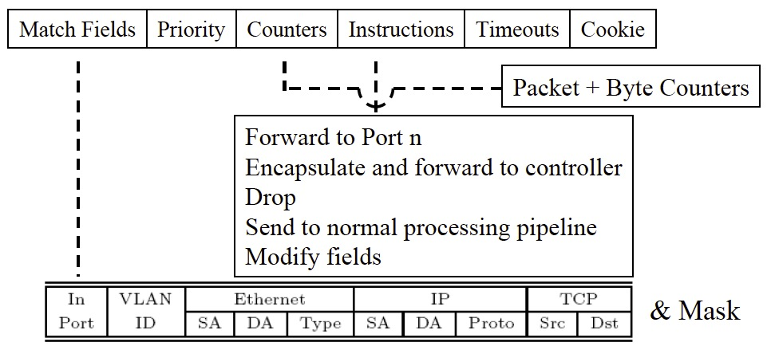
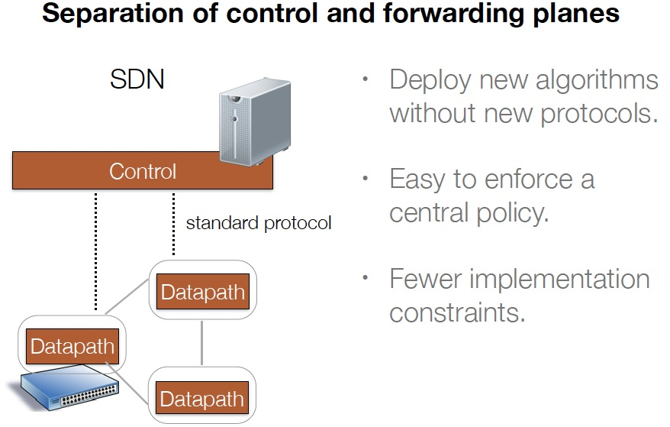
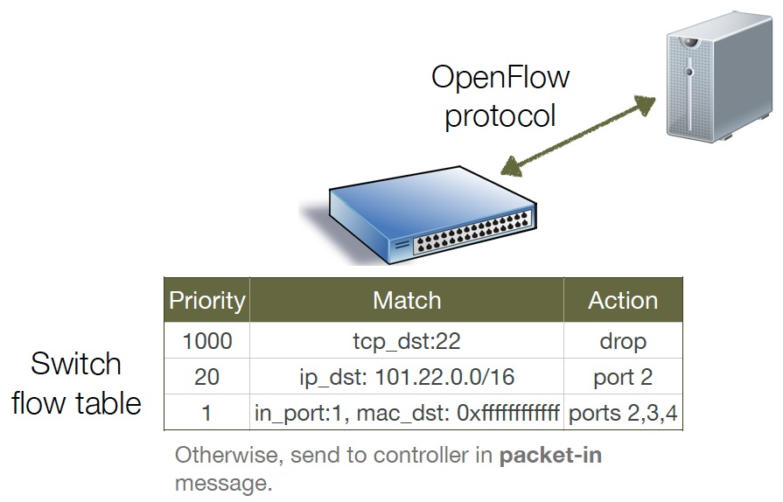
The Programming-Level Gap Problem
- Consider each pkt as a request
- Program invoked on each packet
Low-level TCAM based computing model with limited resources
Notes:
Route onPacket( pkt )

Slide 13

An Example FAST Maple Program
badPort = 22 // policy hostTbl = {A:1,B:2, C:3,D:4} // net view
def onPacket(p):
if badPort == p.tcp_dst: drop
else: forward([hostTbl(p.eth_dst)])
1
2
3
4
A
B
C
D
Assume only packets to A,B,C,D can appear.

Slide 14
Controller Program with Flow Table Management
hostTbl = {A:1,B:2,C:3,D:4}
def onPacket(p):
if 22 == p.tcp_dst: drop
installRule({‘match':{'tcp_dst':22}, ‘action’:[]})
else: forward([hostTbl(p.eth_dst)])
installRule({‘match’: {‘eth_dst’:p.eth_dst, ’tcp_dst’!=22},
‘action’:[hostTbl(p.eth_dst)]})
match does not support logic negation

Slide 15
Controller Program with Flow Table Management
hostTbl = {A:1,B:2,C:3,D:4}
def onPacket(p):
if 22 == p.tcp_dst: drop
installRule({‘priority’:1, ‘match’:{'tcp_dst':22}, ‘action’:[]})
else: forward([hostTbl(p.eth_dst)])
installRule({‘priority’:0, ‘match’: {‘eth_dst’:p.eth_dst},
‘action’:[hostTbl(p.eth_dst)]})

Slide 16
Does the Program Work?
Switch
EthDst:A,
TcpDst:80
{`priority`:0,’match’:{‘eth_dst’:A},'action':[1]}
EthDst:A,
TcpDst:22
A security bug!
Controller
def onPacketIn(p):
if 22 == p.tcp_dst: drop
installRule({`priority`:1,’match’:{‘tcp_dst':22},'action':[]})
else:
installRule({`priority`:0,’match’:{‘eth_dst’:p.eth_dst},
'action':[hostTbl(p.eth_dst)]})
forward([hostTbl(p.eth_dst)])
Notes:
Unfortunately, this program has a bug. To see where the program goes wrong, let’s watch what happens when we connect this controller to a single switch and let two packets arrive. Both packets have destination mac A. The red packet is to TCP destination 80, while the green packet is to TCP destination 22. When the red packet arrives, the switch has an empty flow table and sends the packet to the controller. The controller determines that the packet should be forwarded to the next hop, and installs the appropriate rule. The red packet returns to the switch and moves onward. Now, the port 22 packet arrives at the switch, and instead of being dropped or sent to the controller, it matches the low priority rule for Ethernet destination A and is therefore forwarded onward. This violates the user’s intentions and may represent a security violation.

Slide 17
Example Approach I to Address Issue (OVS): Using Exact Match
hostTbl = {A:1,B:2,C:3,D:4}
def onPacket(p):
if 22 == p.tcp_dst: drop
installRule({‘priority’:1, ‘match’:exactMatch(p), ‘action’:[]})
else: forward([hostTbl(p.eth_dst)])
installRule({‘priority’:0, ‘match’:exactMatch(p),
‘action’:[hostTbl(p.eth_dst)]})

Slide 18
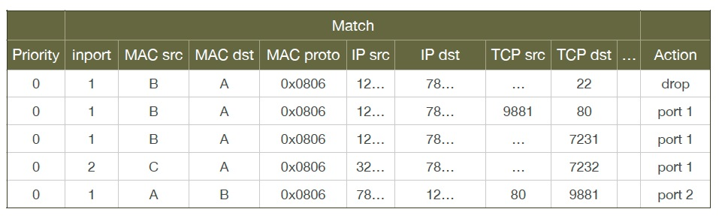
Problems of Example Approach I
Each new TCP flow delayed for flow setup (10-100 ms)
Number of flow table rules may exceed capacity (typically only a few thousands)

Slide 19
Approach II: Declarative Policy Languages
Probably the most well-known is Pyretic [NSDI’13]
if_(match(dstport(22)), drop,
if_(match(dstmac=EthAddr(A)), fwd(1),
if_(match(dstmac=EthAddr(B)), fwd(2),
if_(match(dstmac=EthAddr(C)), fwd(3),
if_(match(dstmac=EthAddr(D)), fwd(4),
flood() )))))

Slide 20
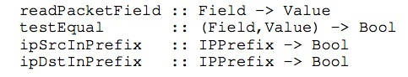
The Maple Approach
Programmer uses the FAST Maple programming model
Derive datapath (flow-tables) from datapath-oblivious programs, without becoming too language dependent
The library-wrapper approach: Only requirement is onPacket uses a simple library to access pkt attributes:
Library provides both convenience and more importantly, decision dependency!
Notes:
On the other hand implementing algorithmic policies is challenging.
We know that naive solutions -- process every packet at controller or use only exact match rules -- perform poorly.
Static analysis to determine layout of flow tables is possible, but has drawbacks; in particular static analysis of general purpose language programs is typically conservative. Furthermore, relying on static analysis will cause the system to become substantially dependent on the source language in which we write algorithmic policies.

Slide 21
Summary of Maple Programming Model
Follow the FAST Maple programming model
onPacket(MaplePacket pkt) “logically” invoked on each packet
Read (MaplePacket.attr()) or test packet attribute (MaplePacket.attrIs()) to make decisions
Write a set of real and virtual packet attributes to provide instruction on how a pkt is handled:
setRoute specifies the path that the packet should take
setPktHeader assigns a new value to the packet header

Slide 22
Exercises: - Setup environment - Use FastMaple IDE to create first Maple project - Write and test M1

Slide 23
Conceptual Intro: Maple Magic using TraceTree

Slide 24
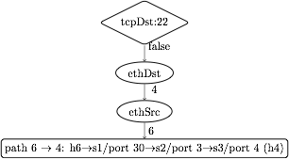
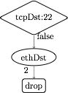
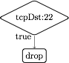
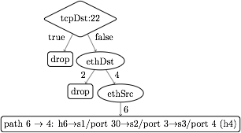
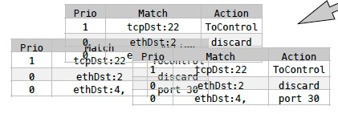
Dynamic Tracing: Abstraction to Flow Tables
1. Observes decision dependency of onPacket on pkt attributes.
2. Builds a trace tree (TT), a universal (general), partial decision tree representation of any onPacket.
3. Compile trace tree to generate flow tables (FTs).
Notes:
Instead, we introduce Maple, a system that implements algorithmic policies using a fully dynamic compilation method and which does not depend on the source language used to express the algorithmic policy.
Maple works by repeatedly executing the user’s algorithmic policy f on packets entering the network, generalizing the outcome to other packets by observing traces of data accesses made during the execution.
Maple then accumulates these traces into a trace tree, which is a partial decision tree of the input algorithmic policy, f.
Finally, Maple compiles flow tables (FTs) for all the switches in the network from the trace tree. The compilation is done so that packets for which Maple has not yet successfully inferred a forwarding decision are sent back to the controller to ensure that Maple continues to execute f and refine its trace tree.

Slide 25
Policy
EthSrc:1,
EthDst:2,
TcpDst:80
Route onPacket(Packet p) {
if (p.tcpDstIs(22))
return null();
else {
Location sloc =
hostTable(p.ethSrc());
Location dloc =
hostTable(p.ethDst());
Route path =
myRoutingAlg(
topology(),sloc,dloc);
return path;
}
}
Assert: TcpDst==22
false
Read: EthSrc
1
Read: EthDst
2
path1
Notes:
We use the example Java algorithmic policy to illustrate the tracing method. Suppose Maple executes the algorithmic policy on a packet with Ethernet source 1, Ethernet dest 2 and tcp destination 80. As the packet moves through the policy, Maple collects a trace of the execution.
When this packet arrives at the check on tcp destination, Maple records the assertion, and its outcome. In this case, the outcome is false. The program proceeds to the else branch, where it reads the source and destination addresses, both of which Maple logs. Finally, the program returns the computed path.

Slide 26
Policy
Trace Tree
EthDst:1,
TcpDst:22
Route onPacket(Packet p) {
if (p.tcpDstIs(22))
return null();
else {
Location sloc =
hostTable(p.ethSrc());
Location dloc =
hostTable(p.ethDst());
Route path =
myRoutingAlg(
topology(),sloc,dloc);
return path;
}
}
Assert: TcpDst==22
Assert: TcpDst==22
true
null
true
false
Read: EthSrc
?
1
Read: EthDst
2
path1
Notes:
Maple then uses this trace to begin generating the Trace Tree. In this case, Maple still doesn’t know what will happen if the assertion is true, and it therefore adds a placeholder under the true branch.
Now, if we execute f on a packet to tcp destination 22, the assertion is true, and the packet is dropped. Maple logs this new trace and uses it to refine its Trace Tree, filling in the true branch of the assertion.

Slide 27
Policy
Trace Tree
EthDst:1,
TcpDst:22
Route onPacket(Packet p) {
if (p.tcpDstIs(22))
return null();
else {
Location sloc =
hostTable(p.ethSrc());
Location dloc =
hostTable(p.ethDst());
Route path =
myRoutingAlg(
topology(),sloc,dloc);
return path;
}
}
Assert: TcpDst==22
Assert: TcpDst==22
true
null
true
false
Read: EthSrc
null
1
Read: EthDst
2
path1
Notes:
Maple then uses this trace to begin generating the Trace Tree. In this case, Maple still doesn’t know what will happen if the assertion is true, and it therefore adds a placeholder under the true branch.
Now, if we execute f on a packet to tcp destination 22, the assertion is true, and the packet is dropped. Maple logs this new trace and uses it to refine its Trace Tree, filling in the true branch of the assertion.

Slide 28
Trace Tree Formal Spec
Assert: TcpDst==22
A tree w/ 4 types of nodes
T node: assertion on packet attributes
V node: multi-way branching on a packet attribute
L node: leaf node labeled w/ action
? node: unknown
TT search: traverse tree for a given packet to determine action or no answer
TT correctness: if TT records an answer for a given packet, the answer is the same as the original algorithm
true
false
Read: EthSrc
?
1
Read: EthDst
2
path1

Slide 29
Trace Tree => Flow Table
tcpDst ==22
True
False
drop
ethDst
match:{tcpDst==22}
4
2
drop
ethSrc
match:{tcpDst!=22, ethDst:2}
6
port 30
match:{tcpDst!=22, ethDst:4,ethSrc:6}
Notes:
The basic compilation algorithm is actually very simple, and we explain it here in the context of an example trace tree. For simplicity the leaves are labeled with switch-specific actions, such as forward on some ports or drop.
The basic algorithm generates one rule for each execution of f, and each execution of f is stored as a path from the root of the trace tree to a leaf. For example, the right-most path in this tree resulted from an execution that observed that tcpDst!=22 and ethDst==4 and ethSrc==6.
The leaf stores the action and the match condition can be obtained from the path from the root to the leaf. In this case, we would want to match on tcpDst!=22, ethDst==4 and ethSrc==6. Of course, as we described earlier, we cannot match on tcpDst!=22, and so instead we will generate a rule at some higher priority that matches on the condition which we wish to negate. This rule, which we call a “barrier rule” ensures that the rule for the execution which we are considering only fires when the condition is false.
We observe that all the rules that require tcpDst!=22 are under the False branch of the assertion node and all the rules that require tcpDst==22 are under the True branch of the assertion node. Therefore, we can determine the priority level of the barrier rule by first generating rules and assigning priorities to the False branch of the node, and then assigning the priority of the barrier rule to have the next higher priority. Then we can assign priorities to the True branch. Hence, by generating rules in-order from False to True, we can correctly assign priorities to rules.
Finally, since the subtree under the True branch may not completely describe how to handle all tcpDst==22 packets, some packets with tcpDst==22 may fall through to the reach the barrier rule. Therefore, the action for the barrier rule must be ToController, so that we can continue to trace f correctly.

Slide 30
Trace Tree => Flow Table
tcpDst ==22
True
False
drop
ethDst
match:{tcpDst==22}
4
2
drop
ethSrc
match:{tcpDst!=22, ethDst:2}
6
port 30
barrier rule:
match:{tcpDst!=22, ethDst:4,ethSrc:6}
match:{tcpDst==22}
action:ToController
Priority

Slide 31
Trace Tree => Flow Table
Maple can use simple, classical in-order tree traversal to automate generation of flow table rules!
tcpDst ==22
3
1
True
False
2
ethDst
drop
match:{tcpDst==22}
4
2
drop
ethSrc
match:{tcpDst!=22, ethDst:2}
6
port 30
barrier rule:
match:{tcpDst!=22, ethDst:4,ethSrc:6}
match:{tcpDst==22}
action:ToController
Priority

Slide 32
Conceptual Intro: Trace Tree Compression

Slide 33
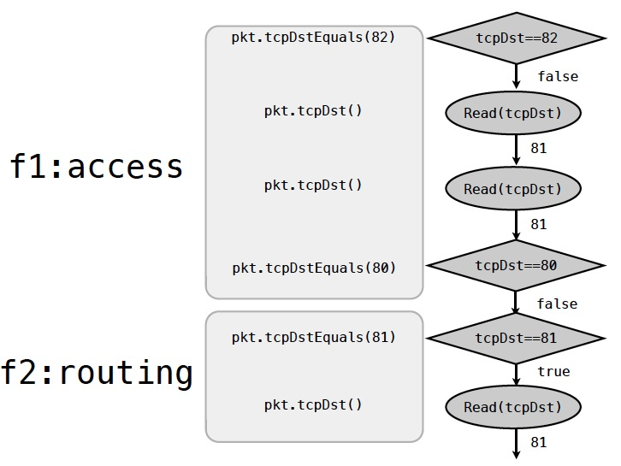
Problem: How to Handle User Inefficiency, such as Redundant Trace?

Slide 34
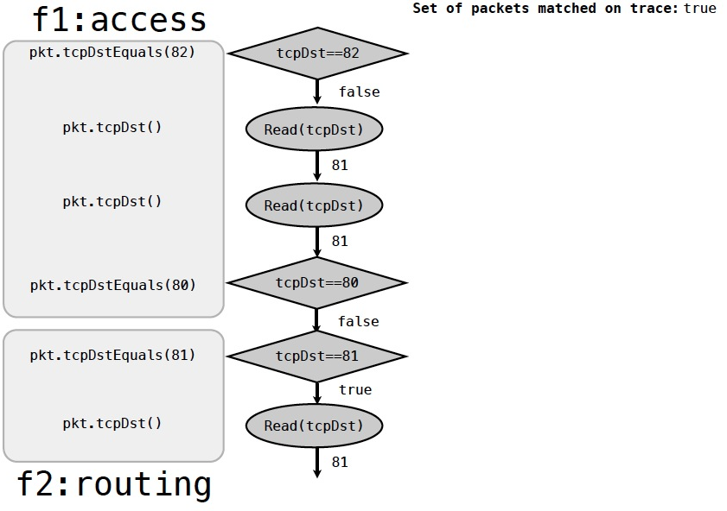
Example: Trace Reduction

Slide 35
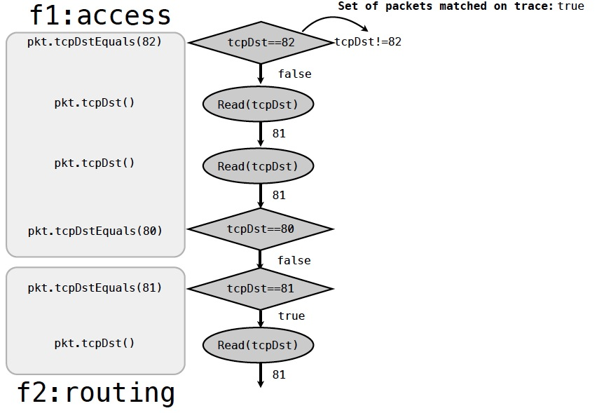
Example: Trace Reduction

Slide 36
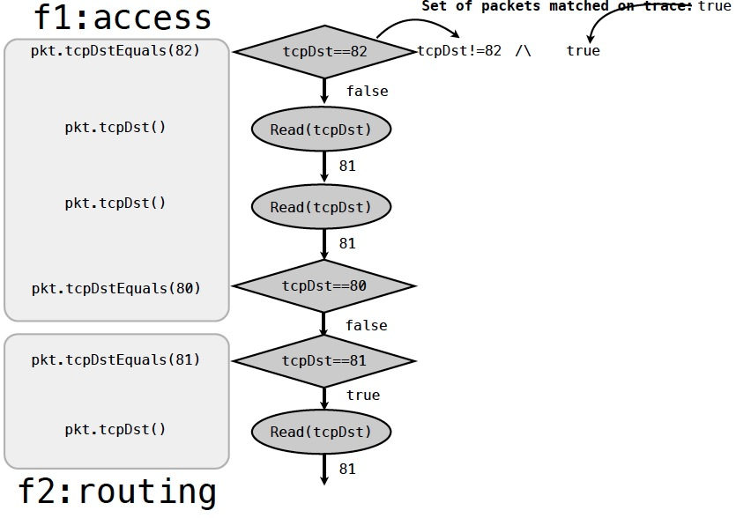
Example: Trace Reduction

Slide 37
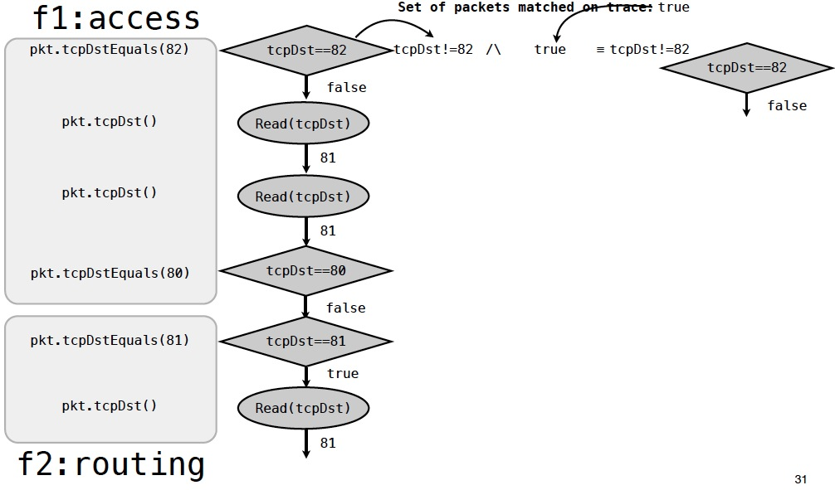
Example: Trace Reduction

Slide 38
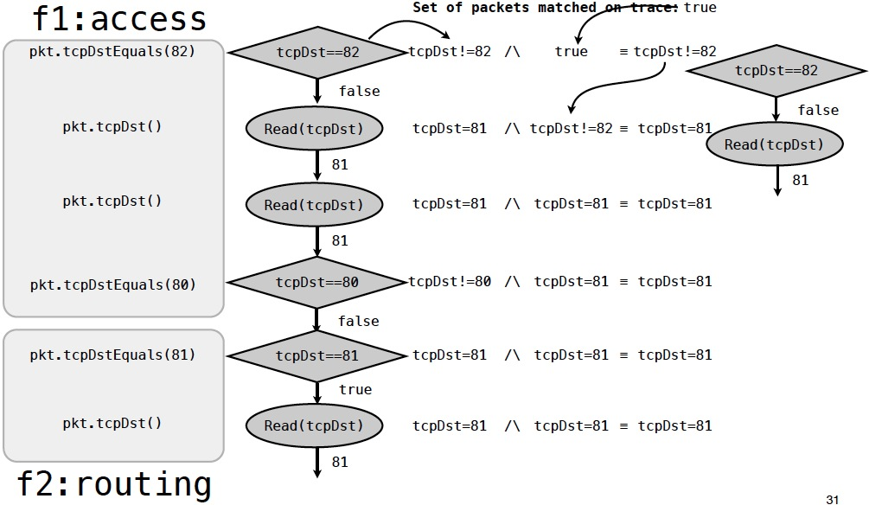
Example: Trace Reduction

Slide 39
Example: Trace Reduction

Slide 40
Exercises: - Try M1 Completion - Write and test M2, M3

Slide 41
Conceptual Intro: Maple Composition

Slide 42
Programming Model: How Does Maple Support Composition?
Problem: a complete onPacket specification may need to handle a large set of different types of packets to be complete, but a programmer may want to customize only a particular type (e.g., TCP over ipv6)
onPacket(Packet p) {
if (p.ethTypeIs(IPv6) && p.ipTypeIs(TCP) )
return my_tcp_ipv6f();
else if (p.ethTypeIs(ARP)) return arpf();
else if (p.ethTypeIs(IPv4))
return ipv4f();
else if (p.ethTypeIs(IPv6)) return ipv6f();
else return drop;
}
onPacket(Packet p) {
if (p.ethTypeIs(IPv6) && p.ipTypeIs(TCP))
my_tcp_ipv6f();
else
return PASS;
}

Slide 43
Implementing Chaining in Maple is Easy
class MapleCore { MapleApp[] mApps;
void init() { // read from config a list // of MapleApp objects to // be loaded }
onPacket(Packet p) { for (MapleApp mApp: mApps) { mApp.onPacket(); if (p.route() != empty) return;
}
} }
MapleApp1 extends MapleApp {
… }
MapleApp2 extends MapleApp {
… }

Slide 44
Exercise: - Write and test M4

Slide 45
Part 3: FAST

Slide 46
Conceptual Intro: The FAST Function Store

Slide 47
Writing an ODL program
public void findPath(Ipv4Address src, Ipv4Address dst,
int requiredBw) {
srcNode, dstNode = mapToNode(src, dst);
touch(binding(src)); touch(binding(dst));
topology = readTopology();
bw_src(x) = (x == srcNode ? +inf : 0);
pq.add(srcNode);
touch(srcNode);
while (!pq.isEmpty()) {
n = pq.pop();
if (bw_src(m) < requiredBw)
return failure
if (n == dstNode)
return setupFlowRules(path);
for (e(n->m): n.neighbors) {
touch(e); touch(m); touch(e.bw);
if (min(e.bw, bw_src(n)) > bw_src(m)) {
updateBw(m, min(e.bw, bw_src(n)));
if (!pq.contains(m))
pq.add(m);
}
}
}
return failure
}
Register listeners for data changes
Clear the side-effects of the program
Filter irrelevant data change in the callback function
Monitor only relevant data changes
only the "touched" nodes/links/bindings
and only the "touched" attributes
...
broker.registerDataChangeListener(..., nodes, listener, BASE);
broker.registerDataChangeListener(..., links, listener, BASE);
broker.registerDataChangeListener(..., linkbw, listener, BASE);
...
public void onDataChanged(event) {
if (oldPath.isNotAffected(event)) return;
removeFlowRulesIfExists(oldPath);
findPath(currentSrc, currentDst, currentRequiredBw);
// with current IP->AP mapping, current topology
// and current link bandwidth
}

Slide 48
Can we NOT do that?
public void findPath(Ipv4Address src, Ipv4Address dst,
int requiredBw) {
srcNode, dstNode = mapToNode(src, dst);
touch(binding(src)); touch(binding(dst));
topology = readTopology();
bw_src(x) = (x == srcNode ? +inf : 0);
pq.add(srcNode);
touch(srcNode);
while (!pq.isEmpty()) {
n = pq.pop();
if (bw_src(m) < requiredBw)
return failure
if (n == dstNode)
return setupFlowRules(path);
for (e(n->m): n.neighbors) {
touch(e); touch(m); touch(e.bw);
if (min(e.bw, bw_src(n)) > bw_src(m)) {
updateBw(m, min(e.bw, bw_src(n)));
if (!pq.contains(m))
pq.add(m);
}
}
}
return failure
}
Register listeners for data changes
Clear the side-effects of the program
Filter irrelevant data change in the callback function
Monitor only relevant data changes
only the "touched" nodes/links/bindings
and only the "touched" attributes
...
broker.registerDataChangeListener(..., nodes, listener, BASE);
broker.registerDataChangeListener(..., links, listener, BASE);
broker.registerDataChangeListener(..., linkbw, listener, BASE);
...
public void onDataChanged(event) {
if (oldPath.isNotAffected(event)) return;
removeFlowRulesIfExists(oldPath);
findPath(currentSrc, currentDst, currentRequiredBw);
// with current IP->AP mapping, current topology
// and current link bandwidth
}

Slide 49
FAST to the rescue
Question: can we write a correct ODL program that is also simple and efficient?
Answer: YES, with FAST

Slide 50
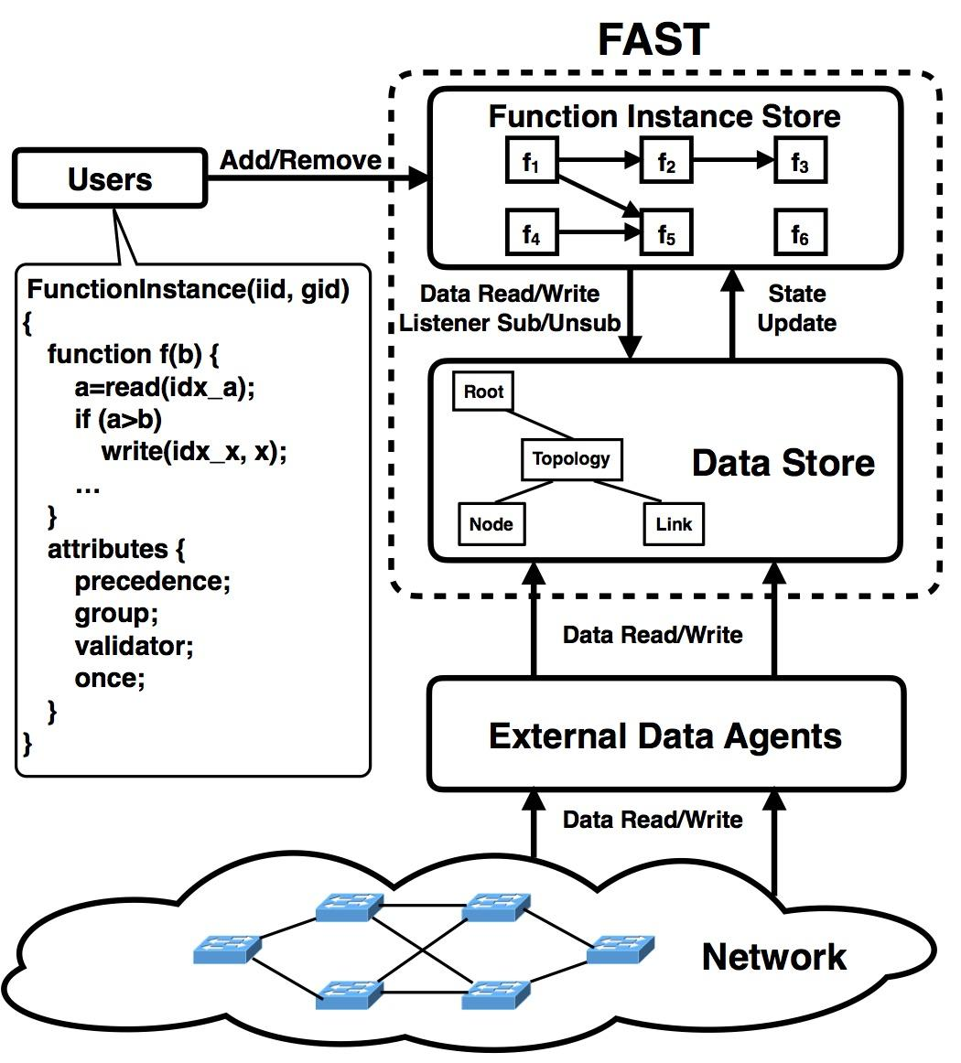
The FAST programming model
Users submit/delete instances at function instance store
Instances access ODL datastore through FAST API
Precedence and grouping to support modular programming and composition

Slide 51
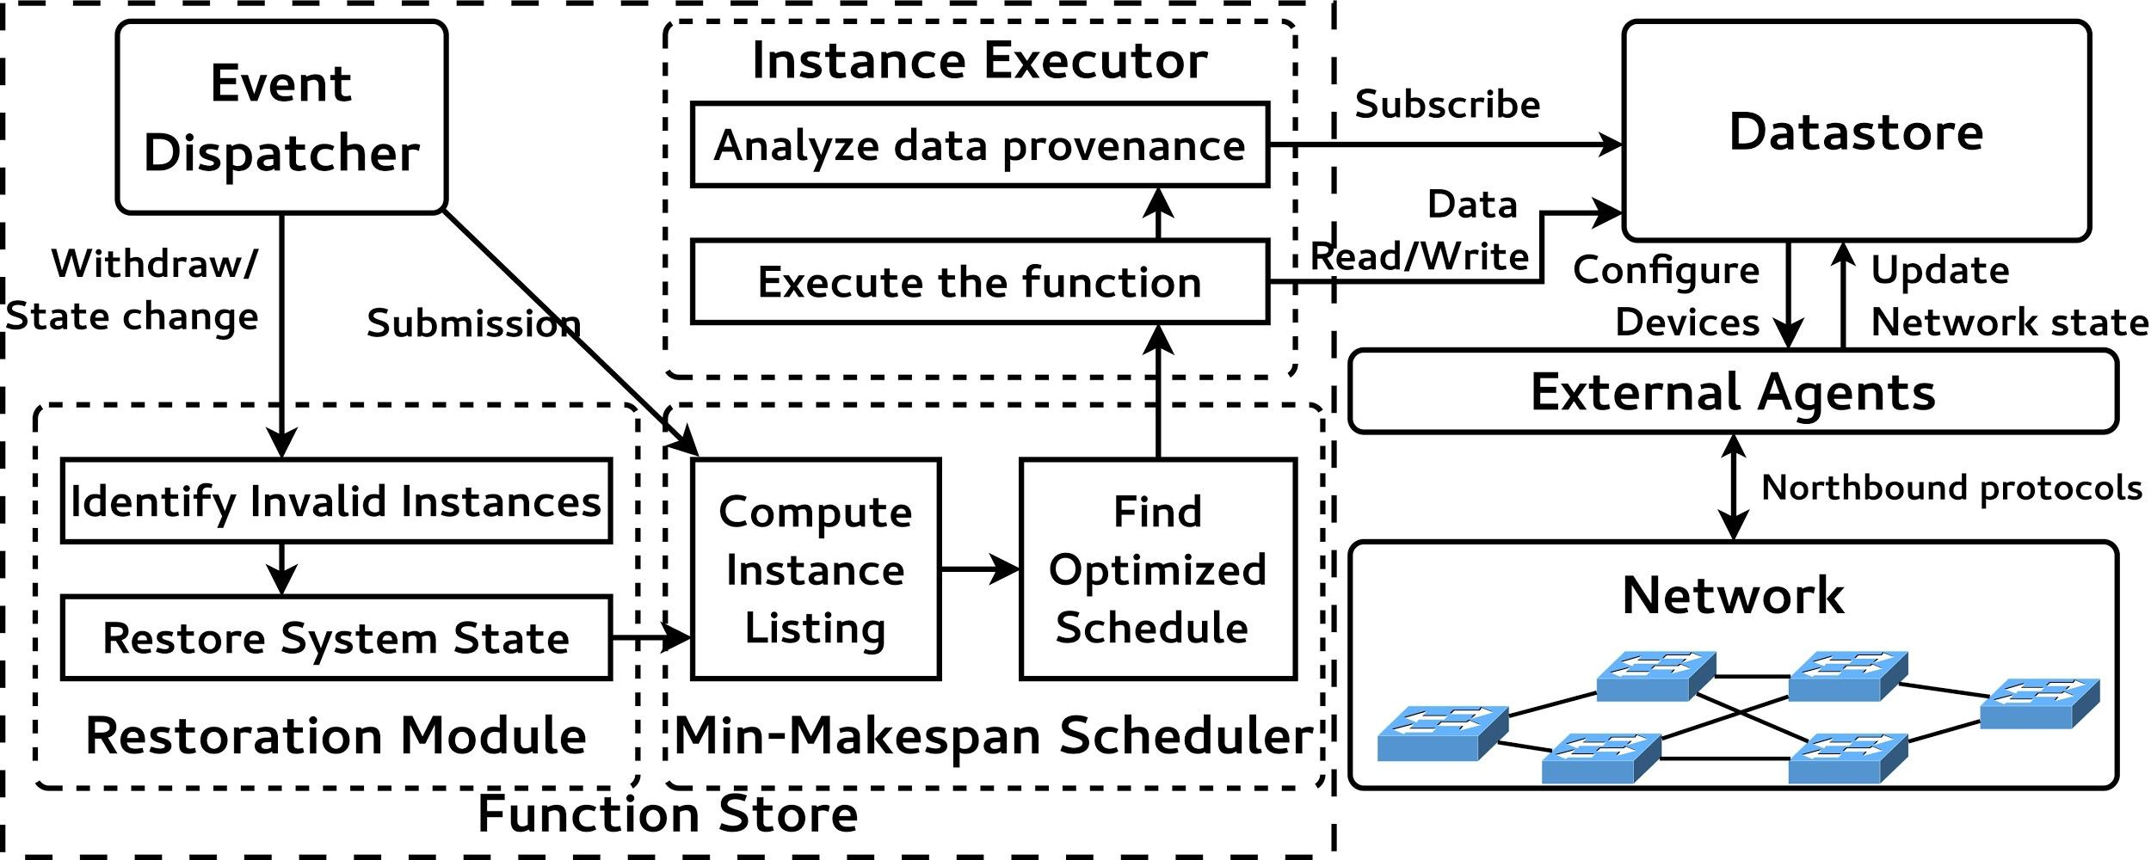
A closer look under the hood

Slide 52
public void findPath(Ipv4Address src, Ipv4Address dst,
int requiredBw) {
srcNode, dstNode = mapToNode(src, dst);
topology = readTopology();
bw_src(x) = (x == srcNode ? +inf : 0);
pq.add(srcNode);
while (!pq.isEmpty()) {
n = pq.pop();
if (bw_src(m) < requiredBw)
return failure
if (n == dstNode)
return setupFlowRules(path);
for (e(n->m): n.neighbors) {
if (min(e.bw, bw_src(n)) > bw_src(m)) {
updateBw(m, min(e.bw, bw_src(n)));
if (!pq.contains(m))
pq.add(m);
}
}
}
return failure
}
RED: the dependent data
Parameters
Data read from the datastore (or more general, the information source)
Automatically track the dependency
BLUE: the output of the program
Data written to the datastore (or more general, the information sink)
Automatically restore the state

Slide 53
Automatic dependency tracking
Requirements:
Capture all the data access
Learn the relationship between data and function instances
Challenges:
How to get fine-grained dependency tracking with ODL DataObject?
How to track primitive types
Solutions:
Java proxy with BA/BI codec
Information flow/Taint analysis

Slide 54
Automatic restoration
Requirements:
Clear all side-effects of dirty function instances
Challenges:
How to identify all “dirty” function instances
How to restore to the correct state
Basic ideas:
Trace “dirty” function instances using the data dependency graph
Keep records of modifications on the data tree

Slide 55
Efficient Two-Phase Scheduling
Requirements:
Maintain the consistency between control plane and data plane
Reduce group commit conflicts
Minimize the schedule makespan
Challenges:
Stochastic instance execution time
Scheduling principles:
Execute instances that writes to data plane first
Execute instances in the same group consecutively

Slide 56
Exercise: - Write and test F1

Slide 57
Part 4: Summary

Slide 58
Bigger Picture
Maple Program
Declarative Policy
Net Elem Datapath
Program
Network State
Program
Net Elem Datapath
FAST
network

Slide 59
Summary
The FAST Maple programming model
The Maple system: a wrapper-based approach to convert datapath-oblivious programs to low-level datapath OF rules
See the Magellan talk on Wednesday on extension
The FAST system: a function store system to compose, and automate data-driven service functions
See the FAST talk on Wednesday on more details
A Web-based (c9 based) based SDN IDE
Additional documents will be made available soon.

Slide 60

Thank You

Slide 61
Maple Details

Slide 62
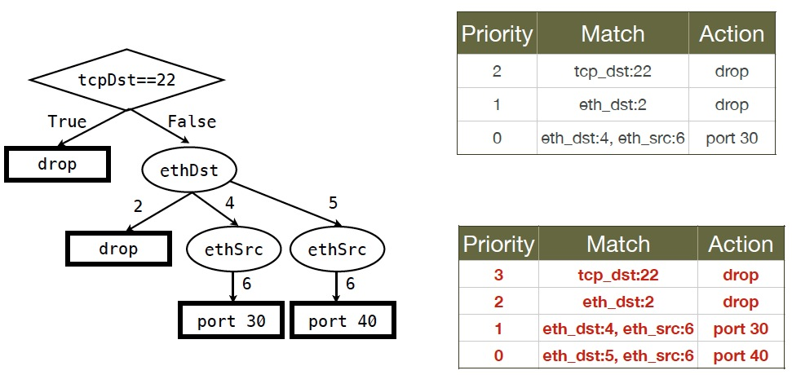
Problem: Simple In-order Traversal Generates Unstable Rules
disjoint, could use same priority.

Slide 63
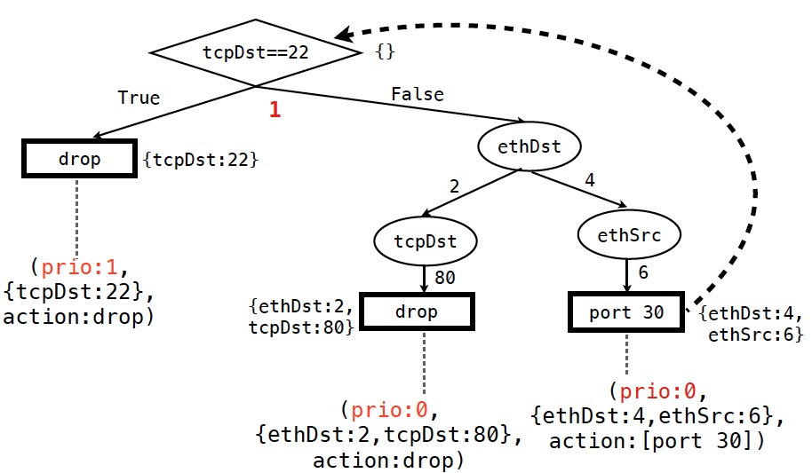
Solution: Minimizing Priority Levels: Increasing at T Nodes Only

Slide 64
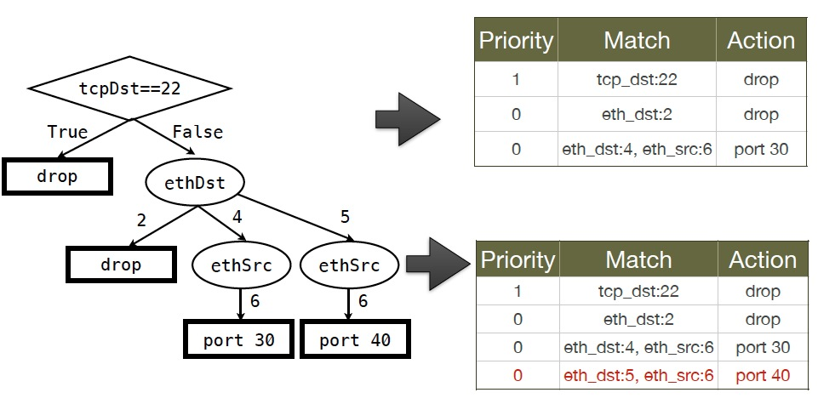
Minimizing Priority Levels: Increasing at T Nodes Only

Slide 65
Minimizing Priority Levels: Increasing at T Nodes Only

Slide 66
Example Algorithmic Policy in Java
Route f(Packet p) {
if (p.tcpDstIs(22)) return null();
else {
Location sloc = hostTable(p.ethSrc());
Location dloc = hostTable(p.ethDst());
Route path = myRoutingAlg(topology(), sloc,dloc);
return path;
}
}
Route myRoutingAlg(Topology topo, Location sLoc, Location dloc) {
if ( isSensitive(sLoc) || isSensitive(dLoc) ) return secureRoutingAlg(topo, sloc, dloc);
else return standardRoutingAlg(topo, sloc, dloc);
}
Does not specify anything on flow tables!
Notes:
Here is an example algorithmic program, written in Java.
Explain program.
Note that the program does not specify flow table configuration.
So the programming model makes the programmer’s life easy: just take a packet and say what to do with it.

Slide 67
Example: “Simple” WAN Link Adaptation [Update]
LossRate[] lossRates; …
Route onPacket(Packet p) {
if ( p.tcpDstIs(22) ) { for (int i =0; i < lossRates.length; i++)
if (lossRates[i] < LOSS_TH) return port[i];
}
return port[0];
}
port 1
port 0
Internet
dedicated link
A branch office setting.

Slide 68
Example: “Complex” ACL+Policy Routing [Update]
Map<MAC, Location> hostTable;
List<ACLItem> acl;
… Route onPacket(Packet p) {
hostTable.put( p.ethSrc(), p.ingressPort() ); // L2 learning
if ( !permit(p, acl) ) return null(); // ACL
Location sloc = hostTable.get( p.ethSrc() );
Location dloc = hostTable.get( p.ethDst() );
Route path = myRoutingPolicy( topology(), // policy routing sloc, dloc);
return path;
}
Route myRoutingAlg(Topology topo, Location sLoc, Location dloc) {
if ( isSensitive( sLoc ) || isSensitive( dLoc ) ) return secureRoutingAlg( topo, sloc, dloc );
else return standardRoutingAlg( topo, sloc, dloc );
}
Notes:
Here is an example algorithmic program, written in Java.
Explain program.
Note that the program does not specify flow table configuration.
So the programming model makes the programmer’s life easy: just take a packet and say what to do with it.

